Slide 1
PowerShell Error Handling
Mike Shepard
Solutions Architect
mshepard70@gmail.com
@mikeShepard70

Slide 2

Shameless self-promotion
My blog (since 2009)– www.PowerShellStation.com
My books
PowerShell Troubleshooting Guide
Getting Started with PowerShell
StackOverflow – top 4% by reputation
Top 1% in PowerShell
Top 5% Windows

Slide 3
What is PowerShell?
Microsoft’s automation platform
Implemented in .NET (.NET core 6.0+)
Includes command-line “scripting language”
PowerShell engine can be embedded in .NET apps
Very flexible, extensible, powerful
Object-based pipeline
Later versions include more “platform” – DSC, JEA

Slide 4
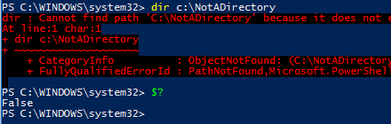
Super-Easy Time!
The built-in variable $? (is that the most cryptic variable name ever?) is a Boolean value which represents the success of the previous statement.
Executables exiting with non-zero codes set $? To False

Slide 5
One more easy thing
$LastExitCode – the exit code from the last executable program (not a function, script or cmdlet)
Be careful…some executables return non-zero for successful operations (E.g. Robocopy)

Slide 6
Now for something familiar
PowerShell has structured exception handling like most modern languages
Try {
}
Catch {
}
Finally {
}
In the beginning of the Catch block, $_ is the exception that was thrown.

Slide 7
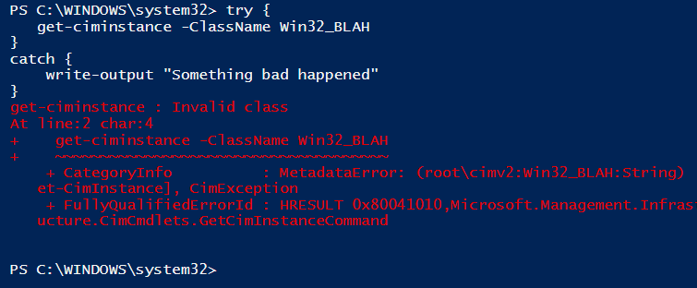
But wait…something’s not right
Some PowerShell errors “sneak through” a try/catch statement

Slide 8
Terminating and Non-Terminating Errors
PowerShell has 2 different kinds of errors
Terminating errors – these are exceptions.
Try/catch will work with these errors
Non-Terminating errors
Try/catch will not get these unless you do something
BUT WHY?

Slide 9
Motivational Slide
If you’re ever in a position where you’re wondering what the PowerShell team was thinking in implementing a feature in a particular way…
Step back and look for their motivation.
In my experience, every time I think that the PowerShell team got it wrong, I find that I’m completely missing the point.
The PowerShell team (in my opinion) has done an exceptional job of creating a robust, flexible, extensible system and has been extremely insightful in their design.

Slide 10
PowerShell Array Parameters
Many (most?) PowerShell cmdlets allow you to pass arrays as arguments
Think about this scenario…
You have a farm of 1000 servers, and have the names in a variable called $servers.
Get-CimInstance –Class Win32_OperatingSystem –ComputerName $servers
What are the odds that all 1000 servers are responding at a given time.

Slide 11
Non-Terminating Errors
A non-terminating error is something that you might need to know about, but doesn’t necessarily need to stop the operation from processing
The default behavior of PowerShell when it encounters a non-terminating error is to:
Write the error to the error stream
Add the error to the $Error collection
Continue processing
When an error “falls out of” the error stream, it is written to the console in a distinctive way that makes it clear it’s an error.

Slide 12
What if I want to “catch” a non-terminating error?
Cmdlets and Advanced Functions have a common parameter called –ErrorAction
Which causes PowerShell to treat non-terminating errors differently:
Values are:
Ignore – don’t add to error stream or variable
SilentlyContinue – don’t add to error stream
Continue – add to error stream and variable (default)
Inquire – Ask the user what to do
Suspend – drop into nested prompt Only in Workflows
Stop – treat the error like an exception

Slide 13
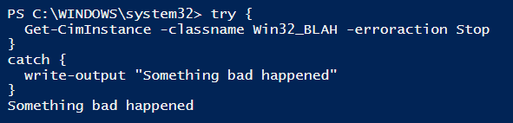
Catching a non-terminating error
Note the –erroraction
This came from the catch block because “Stop” means treat the non-terminating error like an exception

Slide 14
Dealing with 1000 servers (take 1)
$servers=1..1000 | foreach {“Server$_”}
$server_os=get-ciminstance –classname Win32_OperatingSystem -ComputerName $servers
This will not always be successful because of non-responsive servers. We will get all of the
responding servers’ information in the variable, but the non-responsive servers will show
up as errors at the console.

Slide 15
Dealing with 1000 servers (take 2)
$servers=1..1000 | foreach {“Server$_”}
Try{
$server_os=get-ciminstance –classname Win32_OperatingSystem -ComputerName $servers –EA Stop
}
Catch {
write-output “Something went wrong”
}
This will probably not be successful again due to non-responsive servers, but if there are any of those
we won’t get any output at all in the variable because exceptions terminate the statement.

Slide 16
Dealing with 1000 servers (take 3)
$servers=1..1000 | foreach {“Server$_”}
$server_os=@()
Foreach($server in $servers){
Try{
$server_os+=get-ciminstance –classname Win32_OperatingSystem -ComputerName $server –EA Stop
}
Catch {
write-output “Something went wrong with $server”
}
This is a pretty common pattern that will work, but there’s a problem…

Slide 17
Dealing with 1000 servers (take 4)
$servers=1..1000 | foreach {“Server$_”}
Try {
$server_os=get-ciminstance –classname Win32_OperatingSystem -ComputerName $servers `
–ErrorVariable Problems –ErrorAction SilentlyContinue
Foreach($problem in $problems){
write-output “We had a problem with $($problem.OriginInfo)”
}
} catch {
$err=$_
#do something else
}
Here, we get to execute one command which will hit all of the boxes “simultaneously”,
and we get to know what boxes had problems. The best of both worlds!
Note: It won’t always be OriginInfo…sometimes it’s TargetObject. Documentation/practice isn’t very clear on one or the other.

Slide 18
Errors in your code
Create a terminating error (exception) with the Throw statement
Create a non-terminating error with Write-Error
If you want to write an error “properly” create an error record and set useful properties like TargetObject, ErrorDetails, CategoryInfo, etc. so the user will be able to do something with the error.

Slide 19
Questions?

